Slide 1
IPL MATCH WINNER PREDICTION
Algorithm : Random Forest Classifier
Presented By : Aditya Kumar Singh
Registration No. : 12304738
Dataset Used : IPL 2008 – 2023 Dataset

Slide 2
Problem Statement
The goal of this project is to predict the winner of an IPL match using machine learning. By analyzing past match data such as teams, venue, decision, runs, and wickets, the model learns patterns and relationships that help determine which team is more likely to win. This is treated as a classification problem where the model outputs the predicted winning team for any upcoming match.
Target Variable : winner (team name)

Slide 3
Dataset Description
IPL 2008–2023 dataset.
43 columns, 1032 matches.
Key fields : team, toss won, decision, venue name, winner

Slide 4
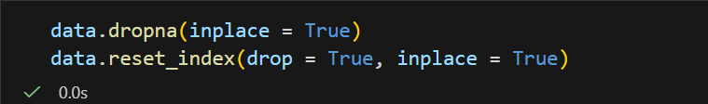
Data Cleaning
Removed rows with missing important values
Dropped columns with too many nulls (umpire, referee, highlight etc.)
Removed “TBA / TBC” dummy teams

Slide 5
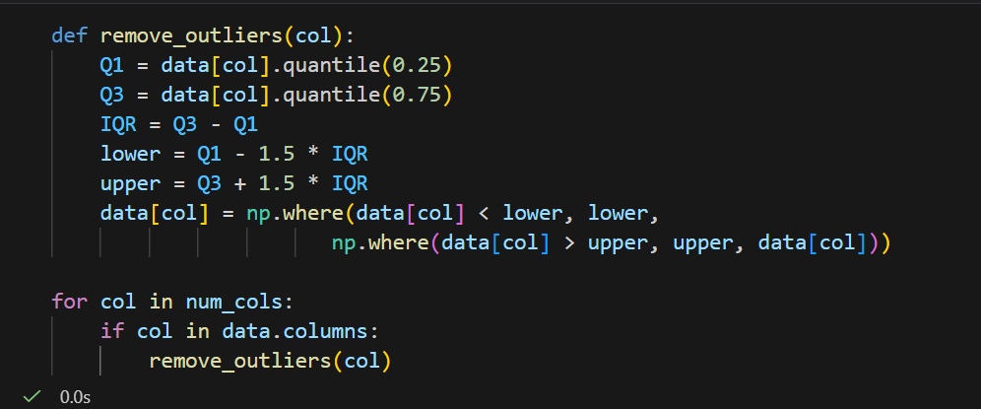
Outlier Handling
Outliers found mainly in runs and wickets columns.
Used IQR Method (Interquartile Range) to smooth extreme values.
Ensures the model is not affected by unusually high or low match scores.
Makes the training data more stable and reliable.

Slide 6
Exploratory Data Analysis (EDA)
Key EDA Steps :
Checked missing values
Visualized distributions of runs and wickets
Studied win trends of teams
Analyzed toss impact on match result
Examined venue-wise performance
Created correlation heatmap

Slide 7
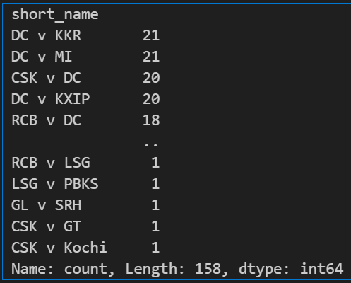
Match Count

Slide 8
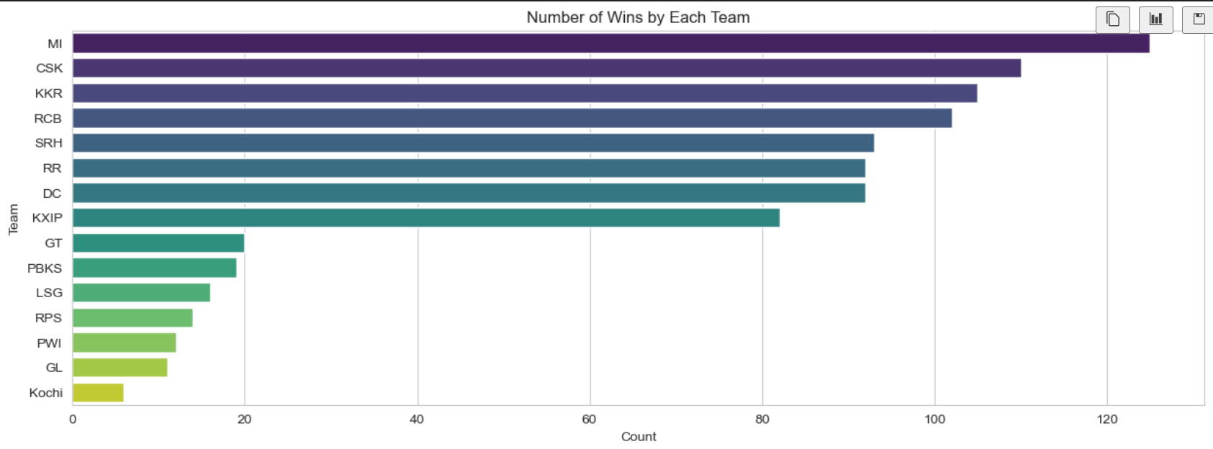
Match Winner Count
Insights :
Some teams consistently appear as top winners (e.g., MI, CSK).
Newer or weaker teams appear lower in the ranking.
This suggests team strength is an important predictive feature.

Slide 9
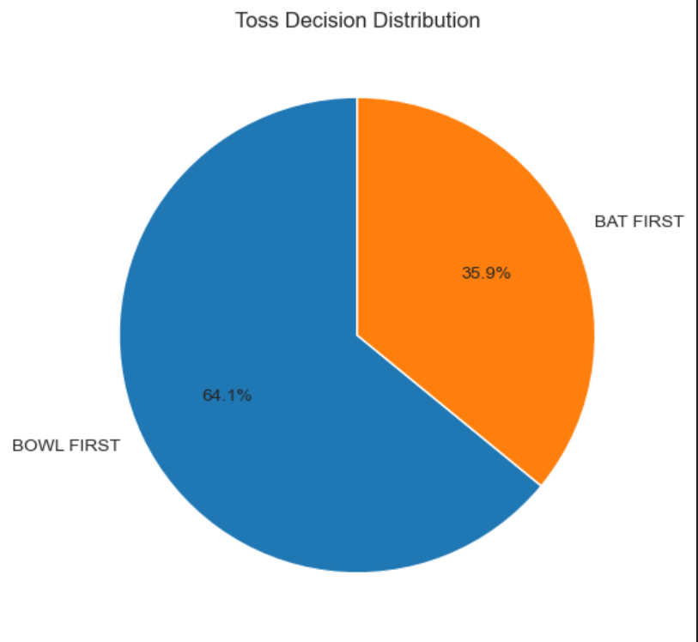
Toss Decision (Bat or Bowl)
Insights :
Toss winners choose to bowl first more often (if % of bowl > bat).
Toss decision can influence match outcome

Slide 10
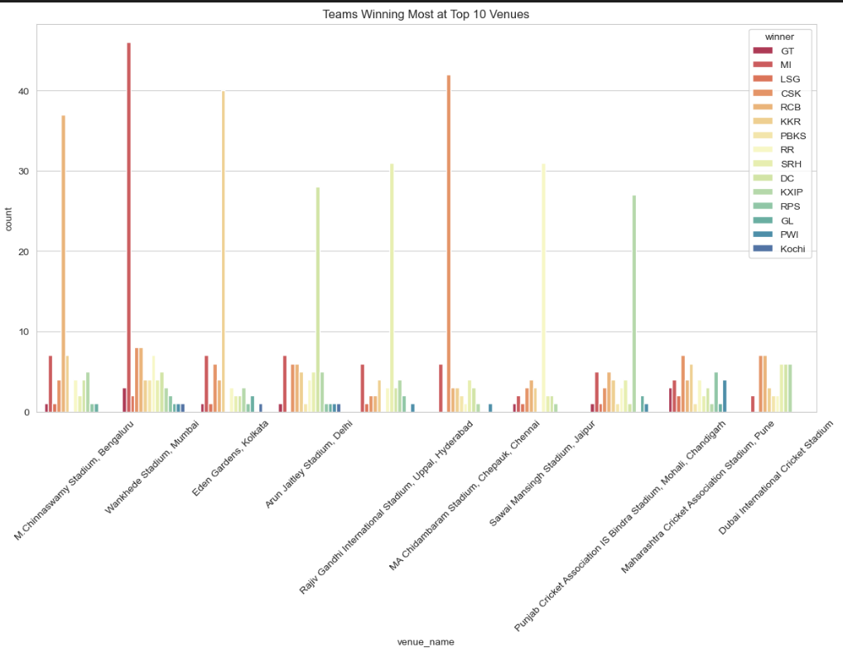
Winning Team by Venue
Insights :
Teams perform significantly better at certain venues.
Home-ground advantage is clear for teams like CSK (Chepauk), KKR (Eden Gardens), etc.
Venue is a highly important feature for predicting winners.

Slide 11
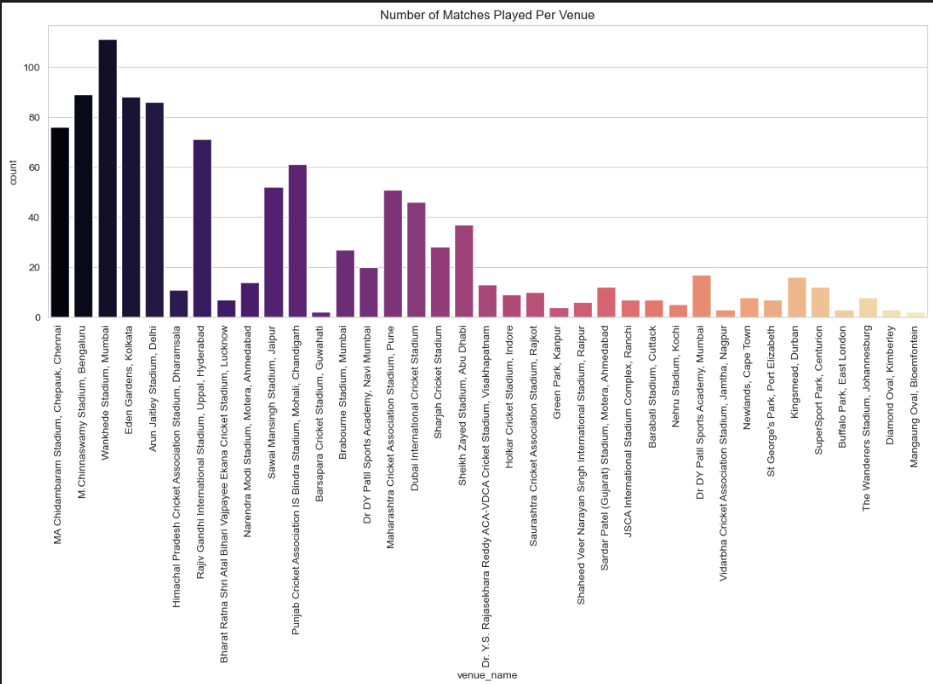
Number of Matches Played Per Venue
Insights :
Wankhede, Chinnaswamy, Eden Gardens, and Chepauk host the most matches, showing IPL’s heavy reliance on major home venues.
Match distribution is highly uneven, with a few stadiums hosting most games while many venues are used only occasionally.
Overseas venues like Dubai, Abu Dhabi, and Sharjah appear due to COVID-era seasons, not regular IPL scheduling.

Slide 12
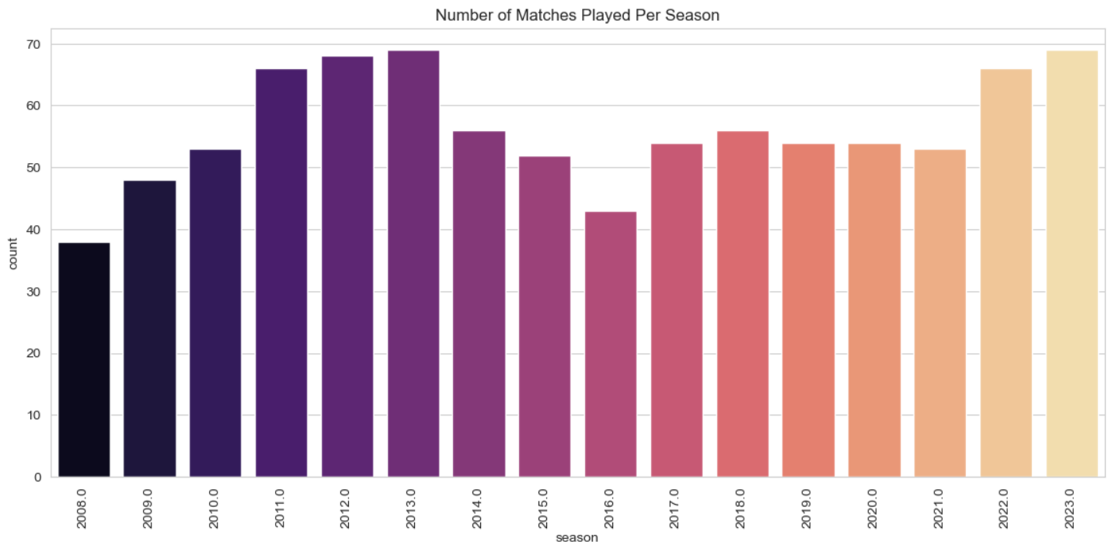
Season-wise Matches Played
Insights :
Number of matches increases in some seasons (expansion teams).
COVID-affected seasons show decreased match count.
Helps understand data distribution across seasons.
Shows IPL growth over time → more data available for recent seasons.

Slide 13
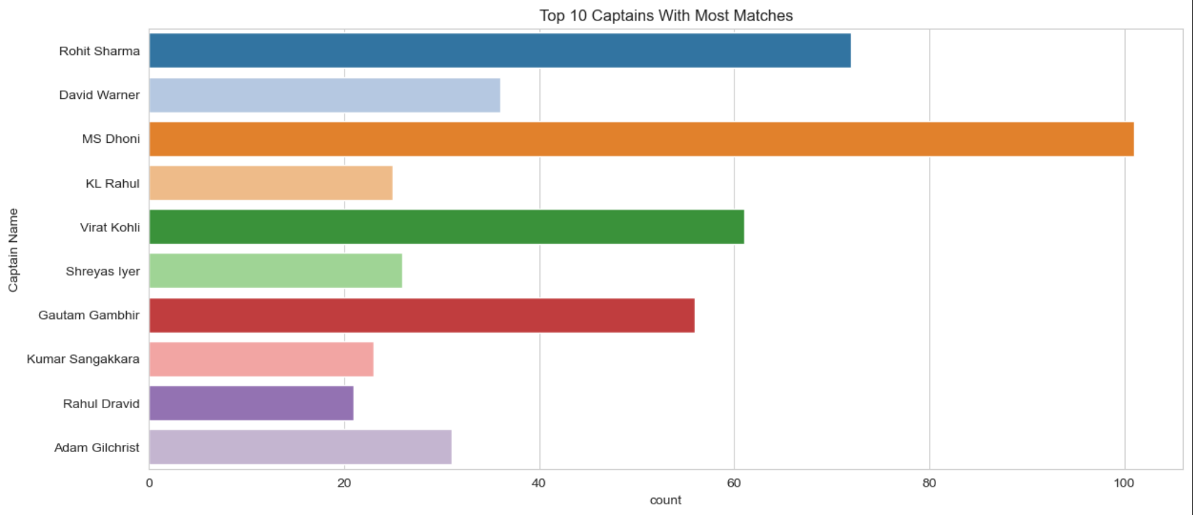
Top 10 Captains With Most Wins
Insights :
Some captains appear consistently for many seasons (Rohit, Dhoni, Kohli).
Leadership stability correlates with team success.
Captaincy experience might indirectly influence match outcome.

Slide 14
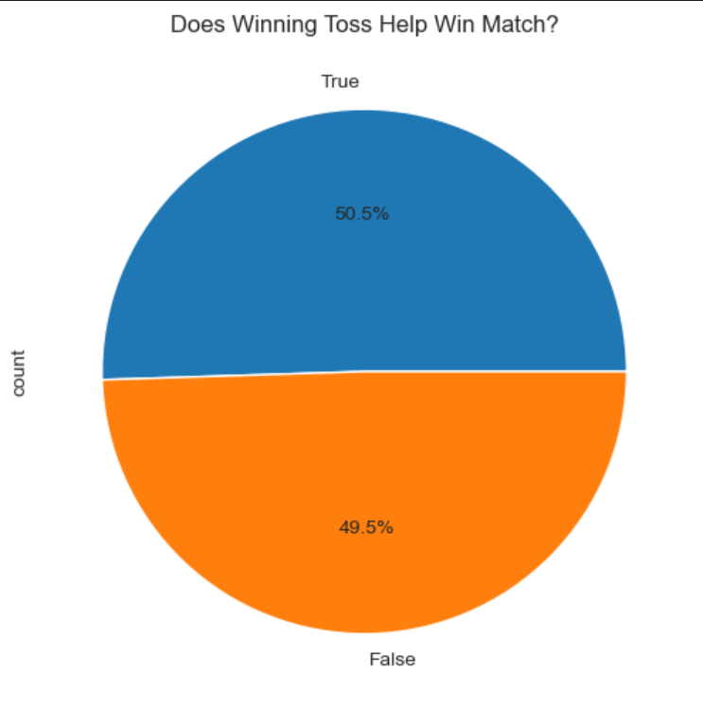
Toss vs Match Winner (Does Toss Matter?)
Insights :
If >50% → Winning toss increases chances of winning the match.
If <50% → Toss doesn’t guarantee match success.
Shows that toss_won is a useful feature but not dominant.

Slide 15
Key Insights From EDA
Certain teams (MI, CSK) dominate wins → team strength matters
Winning toss gives a small advantage (~52%)
Bowling first is more preferred in T20
Venue strongly affects match outcomes
Average score range: 150–180 runs

Slide 16
ML Model Selection
Chosen Algorithm : Random Forest Classifier
Reason :
Works well with mixed data (categorical + numeric)
Handles non-linearity
Less overfitting than Decision Tree
Better accuracy than Logistic Regression
Very reliable for classification tasks

Slide 17
Model Building
Used Random Forest Classifier.
Encoded categorical values with LabelEncoder.
Train-test split 80/20.
Model learns patterns from historical IPL data.

Slide 18
Train-Test Split
80% Training data
20% Testing data
Stratified split used → keeps class balance
Ensures model generalizes well
Prevents biased training

Slide 19
Model Performance
Metrics Obtained:
Accuracy : 0.7038834951456311
Confusion Matrix : Shows correct vs incorrect predictions
Classification Report:
Precision
Recall
F1-score

Slide 20
Winner Prediction Function
A custom function was created to predict match winner
Inputs required:
Two teams
Toss winner
Bat/Bowl decision
Venue
Returns : Predicted winning team

Slide 21
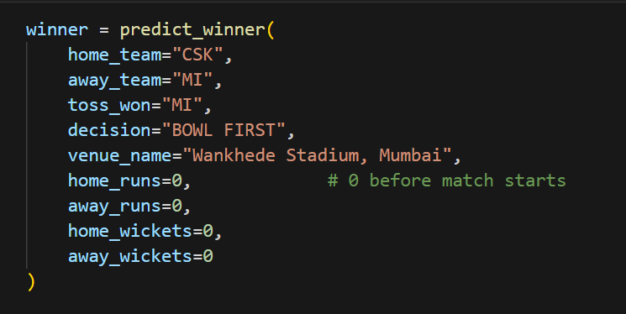
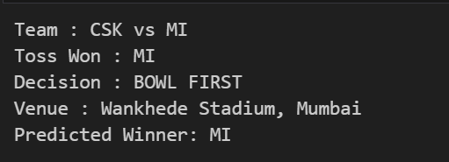
Example Prediction
Input Example :
Model Output :

Slide 22
Conclusion
Random Forest model successfully predicts IPL match winners.
Factors like venue, toss, team strength, and runs/wickets play major roles.
The model achieved strong accuracy and reliable performance.
Machine Learning can be effectively used in sports analytics.

Slide 23
Limitations
Does not include player form or injury updates
Does not use pitch reports or weather data
Match outcome depends on many dynamic factors not in dataseta
Past performance doesn’t always guarantee future results

Slide 24
Future Scope
Add player-level features (runs, wickets, strike rate, economy)
Include ball-by-ball data
Use deep learning for better accuracy
Build a live prediction dashboard
Use web scraping to update model every season

Slide 25
Thank You

